Slide 1
A Directed Artificial bee colony algorithm
Presenter: Terry Yang

Slide 2
01
ABOUT Artificial Bee Colony

Slide 3
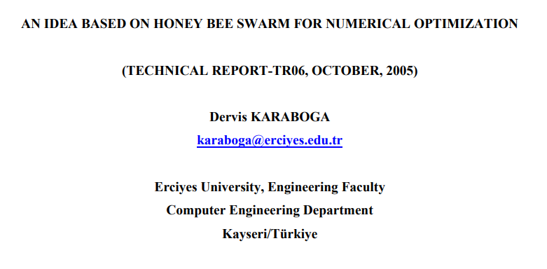
INTRODUCTION
A Swarm intelligence algorithm, similar to ACO(ant), PSO(bird), using self-organization and division of labor, helping the Swarm adapts to the given environment.
4 ways the individuals reacts to each others: positive feedback, negative feedback, fluctuations, and multiple interactions
3 kinds of objects in simulation system: Food source, Employed bee, and Unemployed bee(scouts and onlooker bee).
Notes:
swarm intelligence as
“any attempt to design algorithms or distributed problem-solving devices inspired by the collective behavior of social insect colonies and other animal societies”

Slide 4
02
Detail Procedure of ABC

Slide 5
Division of Labor
01
02
03
Employed Bee
On-looker Bee
Scout Bee
Associated with a particular food source, share this source with a certain probability.
Choose a certain food source via probability and others bees’ information. Than become employed bee
When the current food source is exhausted. The employed bee become scout bee, to search new food source.

Slide 6
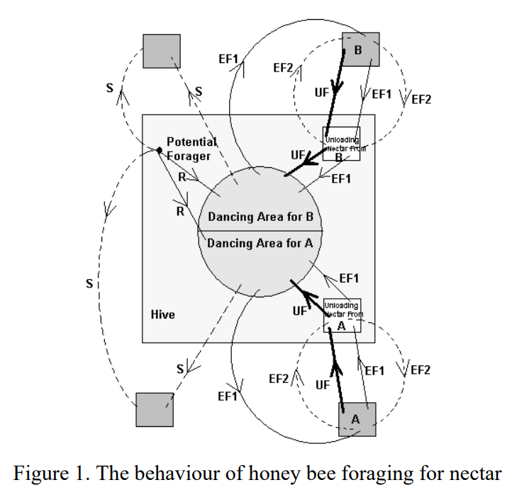
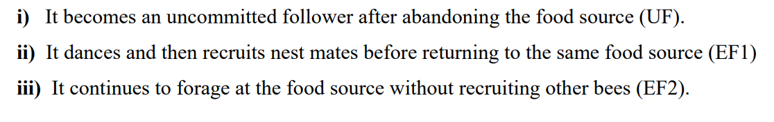
Job transforming
Cross over
EB
Recruited
UF
Source exhaust
Source found
OB
SB
Notes:
swarm intelligence as
“any attempt to design algorithms or distributed problem-solving devices inspired by the collective behavior of social insect colonies and other animal societies”

Slide 7
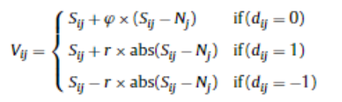
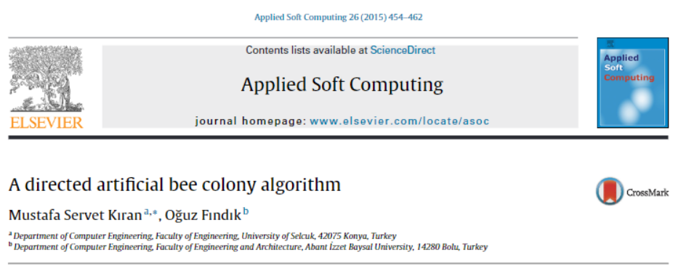
A directed artificial bee colony algorithm
Adding directional factor to improve original ABC randomly search for food source
S is artificial bee
N is food source location
d is a directional factor
r is a random number between [0, 1]
φ is a random number between [-1, 1]

Slide 8
Iteration Procedure
Employed Bee Phase
On-looker Bee Phase
Scout Bee Phase
Selection Phase
Observe other food source via information from other bee .
By fitness value, decide which food source to go.
When current food source is exhausted, go scouting other sources.
Update food source location remaining amount. And update best gathering spot.

Slide 9
03
Future Plans for SCMA Final Project

Slide 10
TSP
Numerical
Solving benchmark
Problems
For TSP problem, compare optimization results with permutation GA, ACO algorithms
For continuous numerical problem, compare optimization results with real number GA, PSO algorithms

Slide 11
Reference
AN IDEA BASED ON HONEY BEE SWARM FOR NUMERICAL OPTIMIZATION by Dervis KARABOGA
- https://abc.erciyes.edu.tr/pub/tr06_2005.pdf
A directed artificial bee colony algorithm
by Mustafa Servet Kırana & Oğuz Fındıkb
- https://www.sciencedirect.com/science/article/pii/S1568494614005304
【ABC演算法】人工蜂群演算法原理及程式碼 | 程式前沿 - https://abc.erciyes.edu.tr/pub/tr06_2005.pdf
Python — 人工蜂群演算法(Artificial Bee Colony, ABC) - https://huntercheng1013.medium.com/python...
Notes:
swarm intelligence as
“any attempt to design algorithms or distributed problem-solving devices inspired by the collective behavior of social insect colonies and other animal societies”

